Slide 1
Assay Library generation

Slide 2
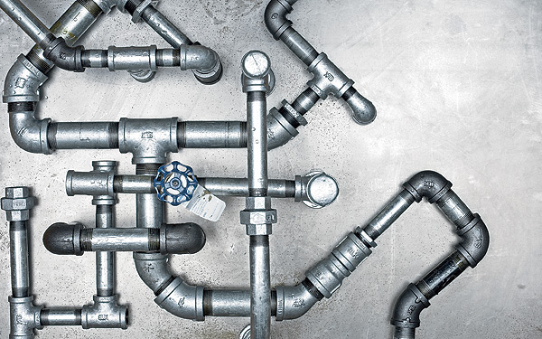
Library generation
Mascot - .dat files -> PSM’s
Bibliospec
All PSM’s with Mascot e-score < 0.05 are included
Select best PSM for each precursor
specL
Filter spectra for ion type (y, b)
Filter spectra for mass accuracy
Select top m:n transitions
Perform RT calibration
Annotate peptides

Slide 3

Parameters
Fasta file to search is taken from the dat file
Default filtering function is used (+1,+2 fragments and y and b ions only)
Fragment Ion range 300-1250
User parameters ?:
Min ions per assay (default 6)
Max ions per assay (default 6)
MZ-error (default 0.05) (or take it from dat file?)

Slide 4
Protein identification from peptides

Slide 5
Open
Filtering peptides:
Mascot e-value < 0.05 (mascot score of 13)
Fast fix – infer mascot score in scaffold in provide user parameter
Peptide protein assignment
Given peptide sequence list all matching proteins in fasta file (in the order they are in the fasta file).

Slide 6
Problem 1 - peptide to protein?

Slide 7
Problem 2 – Which proteins are there?

Slide 8

prozor (protein –razor)
razor proteins (Maxquant)
Implementation in R (prozor – on github and CRAN)
Computes:
Smallest protein set explaining peptides
can also takes into account if peptide is matching multiple proteins: peptides matching many proteins not as important (default).
Smallest protein set explaining the AA
Protein set with largest protein sequence coverage

Slide 9
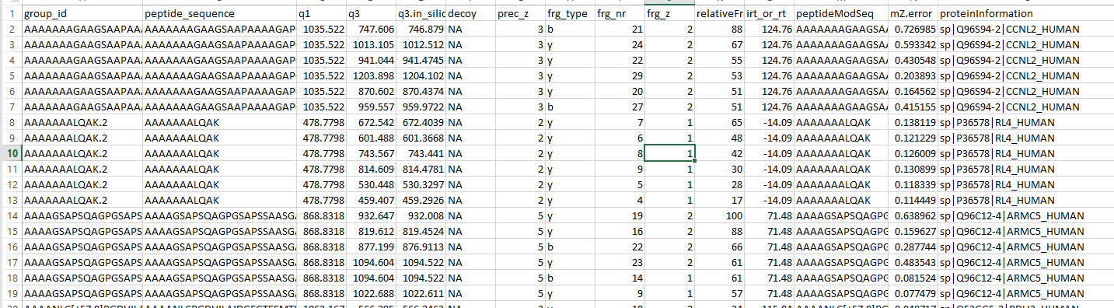
Output – spectronaut compatible output

Slide 10
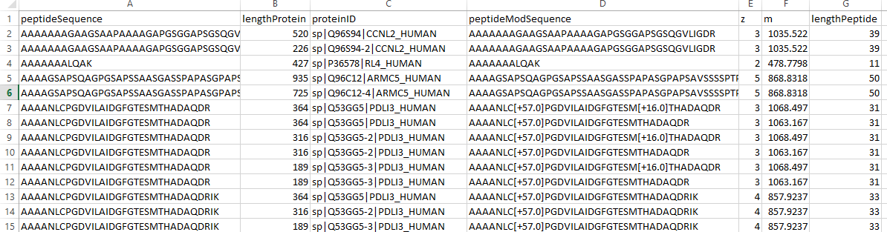
Output – all peptide protein mappings

Slide 11
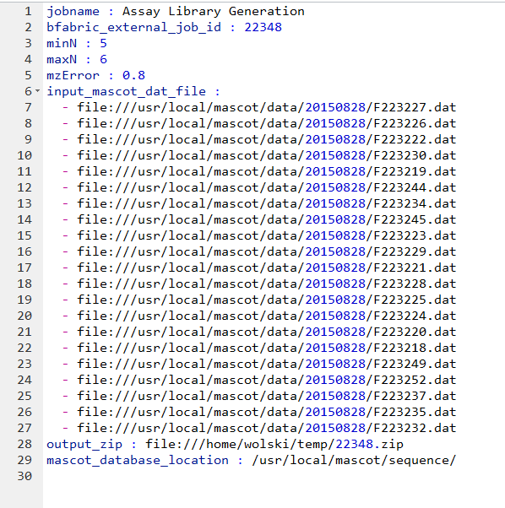
Output - Workflow parameters

Slide 12
Output – Library generation report

Slide 13

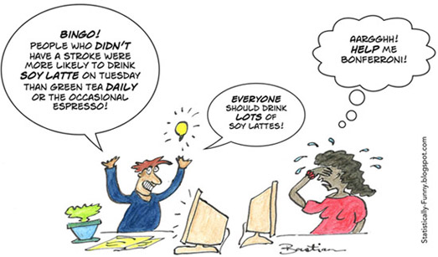
todo
Automatic fdr estimation on peptide level using bibliospec and R
Reduce number of parameters
Provide more ouputs:
library with proteotypic p
Library without peptides with more than X (3) protein assignments

